Slide 1
W4111 – Introduction to Databases Module II (4), NoSQL (4)
© Donald F. Ferguson, 2025

Slide 2

Contents
2 | W4111-2025S-13-Module-II-NoSql-Module-IV-2 © Donald F. Ferguson, 2025

Slide 3
Contents
Course update
Module IV – EII, ETL/ELT, Data Warehouse, Data Lake reminder
Star schema – Reminder
OLAP continued
Cubes
Operations
Example of star schema, OLAP, … … in relational
Schema definition
ETL
Some queries
Big Data and Tools
Concepts
MapReduce
Spark, pySpark and some examples

Slide 4
Course Overview
4 | W4111-2025S-13-Module-II-NoSql-Module-IV-2 © Donald F. Ferguson, 2025

Slide 5
Course Overview
Final lecture
I am in a meeting during lecture time.
I will record the lecture, and segments will begin appearing this weekend.
It will cover miscellaneous topics and walking through HW 5 project.
Homework 5
HW 5A will be a set of written questions. Due next weekend.
HW5B
Will be completing the project template.
I am in the process of simplifying the requirements and providing additional code.
Will be due at the end of the final exam period.
Final exam
Proctorio, Online, Will be released approximately next weekend. Due last day of finals.
There will be two versions:
A non-cumulative version
An optional set of additional questions that form a cumulative exam
You have to pick if you are submitting only the non-cumulative or both parts.

Slide 6
Introduction to Enterprise Information Integration ETL
Data Warehouse, Data Lake Reminder
6 | W4111-2025S-13-Module-II-NoSql-Module-IV-2 © Donald F. Ferguson, 2025

Slide 7
Enterprise Information Integration

Slide 8
Data Warehouse and Data Lake

Slide 9
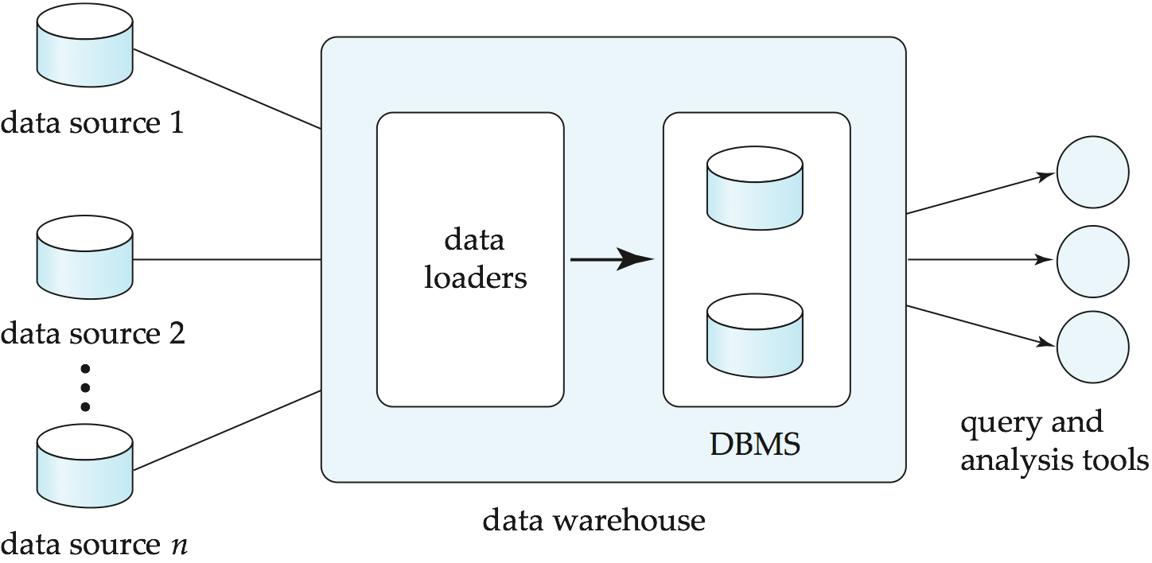
Data Warehousing

Slide 10
Overview (Cont.)
Common steps in data analytics
Gather data from multiple sources into one location
Data warehouses also integrated data into common schema
Data often needs to be extracted from source formats, transformed to common schema, and loaded into the data warehouse
Can be done as ETL (extract-transform-load), or ELT (extract-load-transform)
Generate aggregates and reports summarizing data
Dashboards showing graphical charts/reports
Online analytical processing (OLAP) systems allow interactive querying
Statistical analysis using tools such as R/SAS/SPSS
Including extensions for parallel processing of big data
Build predictive models and use the models for decision making

Slide 11
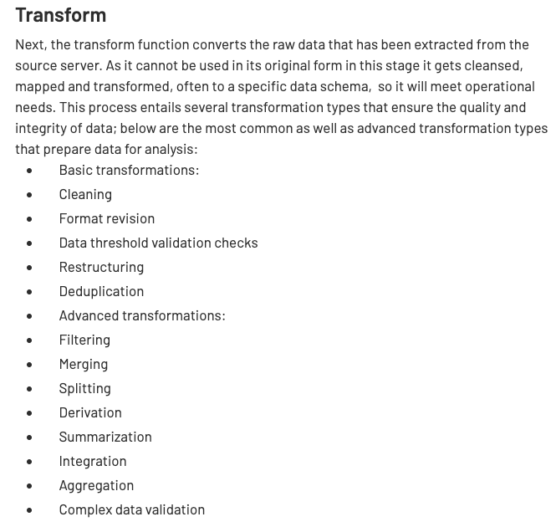
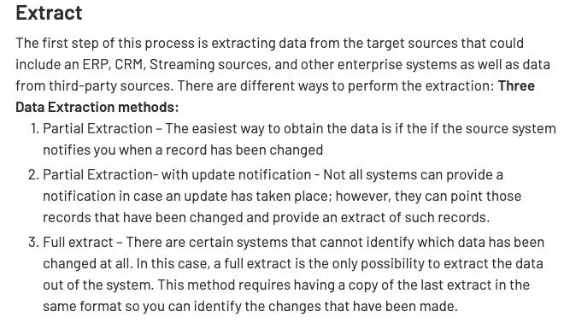
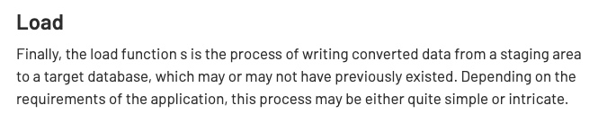
ETL Concepts
https://databricks.com/glossary/extract-transform-load

Slide 12
Star Schema
12 | W4111-2025S-13-Module-II-NoSql-Module-IV-2 © Donald F. Ferguson, 2025

Slide 13
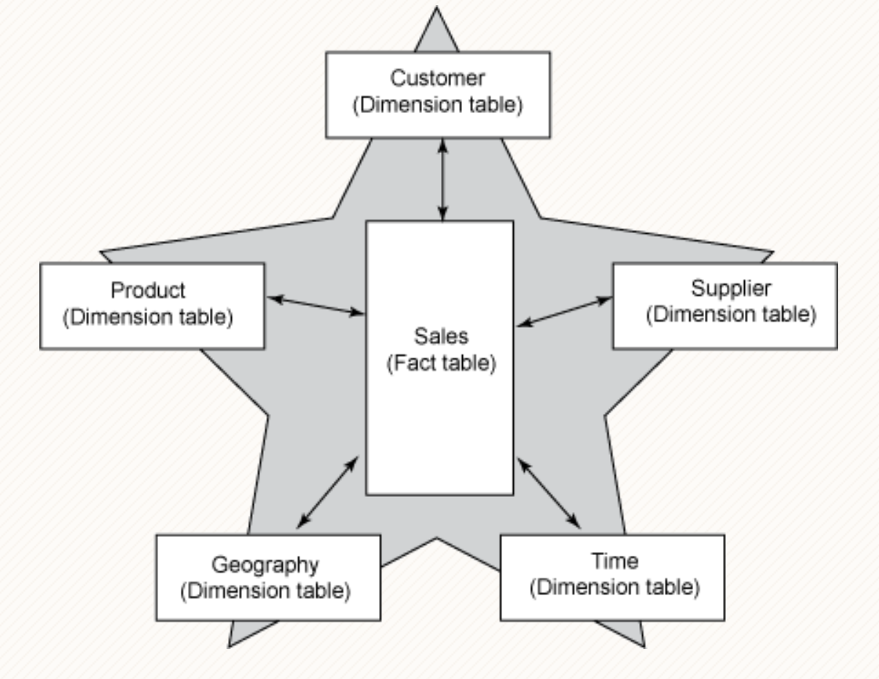
Facts and Dimensions
A common model for (some) data in a date warehouse is a star schema.
There are one or more fact tables that have records for small facts, e.g.
Sold product A.
To customer B.
At price C.
Facts are positioned in dimensions, e.g.
Date, time
Location
Product category
… …
Queries ask for summations and aggregations in dimensions, e.g.
Total sales of products in category X, to customers in country Y during year Z.
Queries can roll-up, drill down, pivot, … …
This is a generalization of the spreadsheet concept of pivot tables.

Slide 14
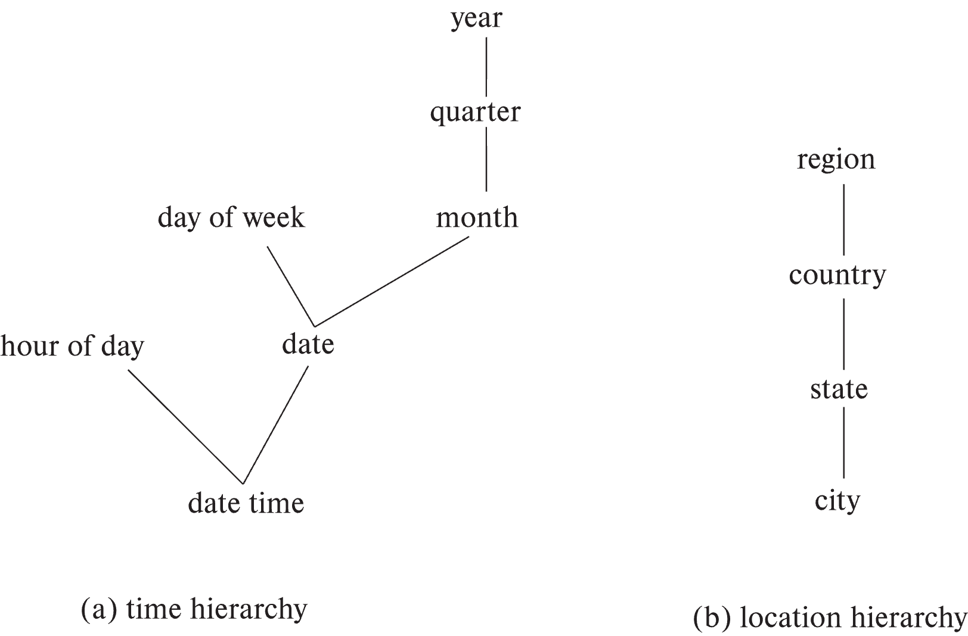
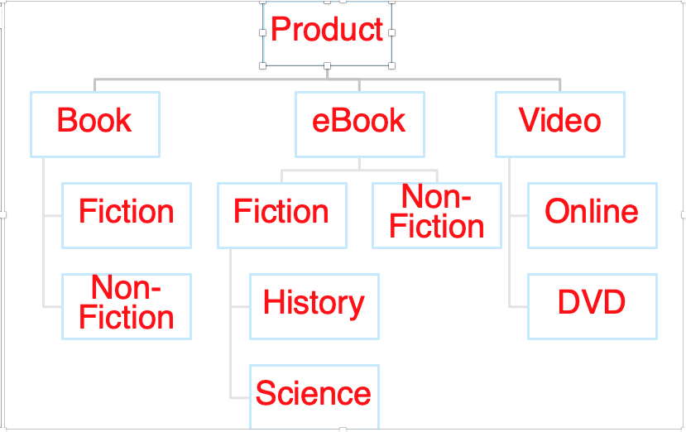
Hierarchies on Dimensions
Hierarchy on dimension attributes: lets dimensions be viewed at different levels of detail
E.g., the dimension datetime can be used to aggregate by hour of day, date, day of week, month, quarter or year
Another dimension could be ... Product category.

Slide 15
Another Dimension Example – Product Categories
Product
Book
eBook
Video
Fiction
Non-Fiction
Non-
Fiction
Fiction
Online
DVD
History
Science

Slide 16
OLAP
16 | W4111-2025S-13-Module-II-NoSql-Module-IV-2 © Donald F. Ferguson, 2025

Slide 17
Data Analysis and OLAP
Online Analytical Processing (OLAP)
Interactive analysis of data, allowing data to be summarized and viewed in different ways in an online fashion (with negligible delay)
We use the following relation to illustrate OLAP concepts
sales (item_name, color, clothes_size, quantity)
This is a simplified version of the sales fact table joined with the dimension tables, and many attributes removed (and some renamed)
For Classic Models, this would be:
sales(productCode, quantityOrdered, priceEach)
But, I need to link with dimensions.
Date
Location
ProductType
➔
sales(productCode, quantityOrdered, priceEach, date_dimension_id, location_dimension_id, product_type_dimension_id)
We are only going to worry about date and location for now.

Slide 18
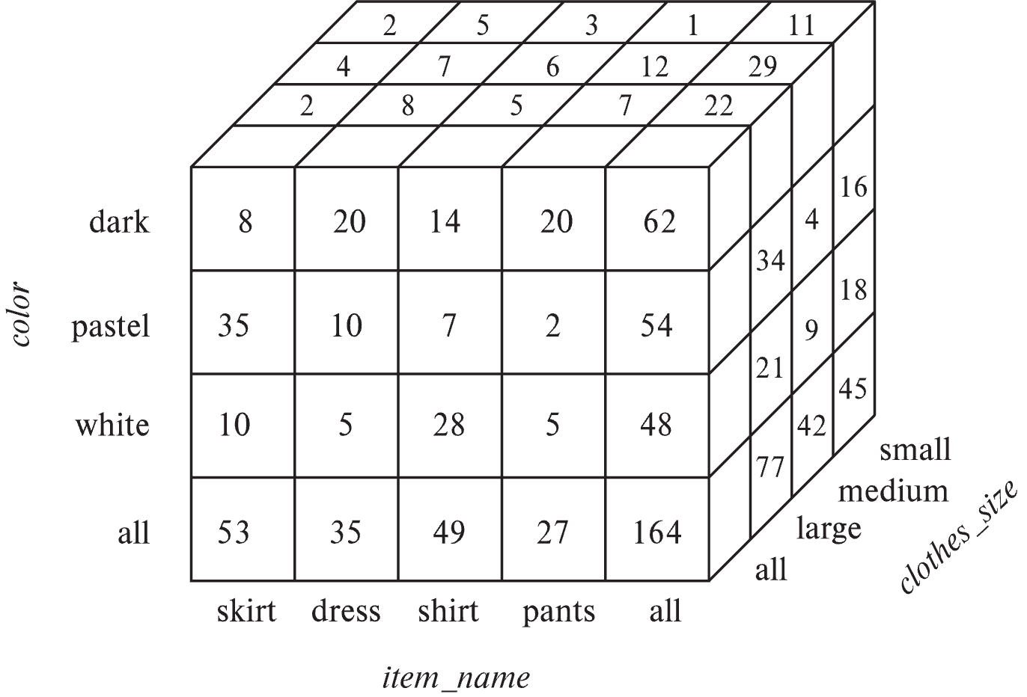
Data Cube
A data cube is a multidimensional generalization of a cross-tab
Can have n dimensions; we show 3 below
Cross-tabs can be used as views on a data cube

Slide 19
Online Analytical Processing Operations
Pivoting: changing the dimensions used in a cross-tab
E.g., moving colors to column names
Slicing: creating a cross-tab for fixed values only
E.g., fixing color to white and size to small
Sometimes called dicing, particularly when values for multiple dimensions are fixed.
Rollup: moving from finer-granularity data to a coarser granularity
E.g., aggregating away an attribute
E.g., moving from aggregates by day to aggregates by month or year
Drill down: The opposite operation - that of moving from coarser-granularity data to finer-granularity data

Slide 20
Hierarchies on Dimensions
Hierarchy on dimension attributes: lets dimensions be viewed at different levels of detail
E.g., the dimension datetime can be used to aggregate by hour of day, date, day of week, month, quarter or year
Another dimension could be ... Product category.

Slide 21
Another Dimension Example – Product Categories
Product
Book
eBook
Video
Fiction
Non-Fiction
Non-
Fiction
Fiction
Online
DVD
History
Science

Slide 22
Facts and Dimensions

Slide 23
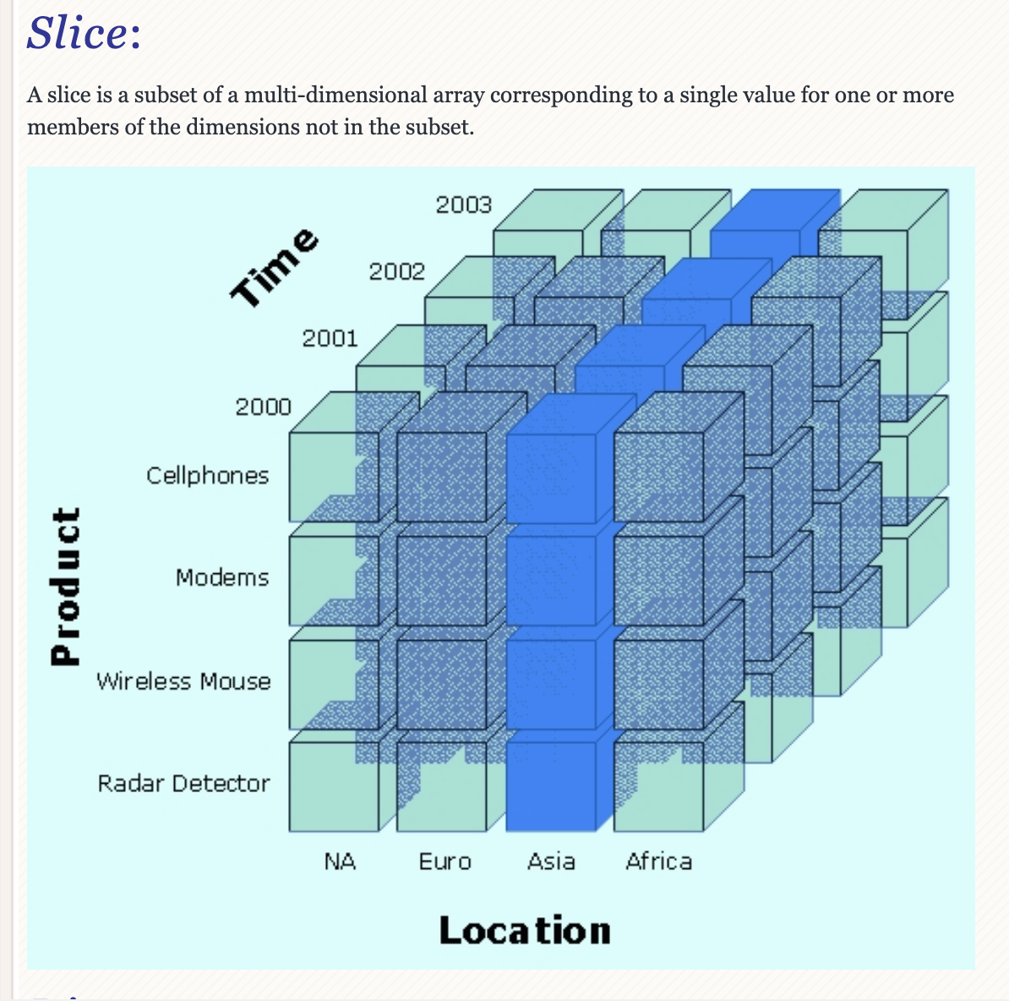
Slice

Slide 24
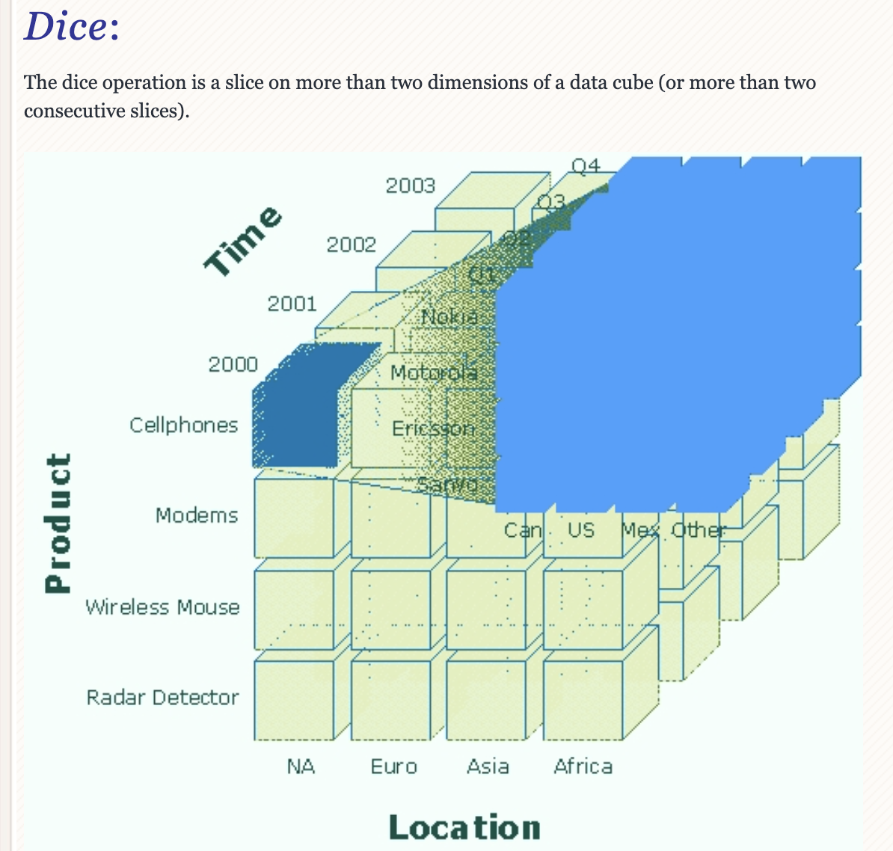
Dice

Slide 25
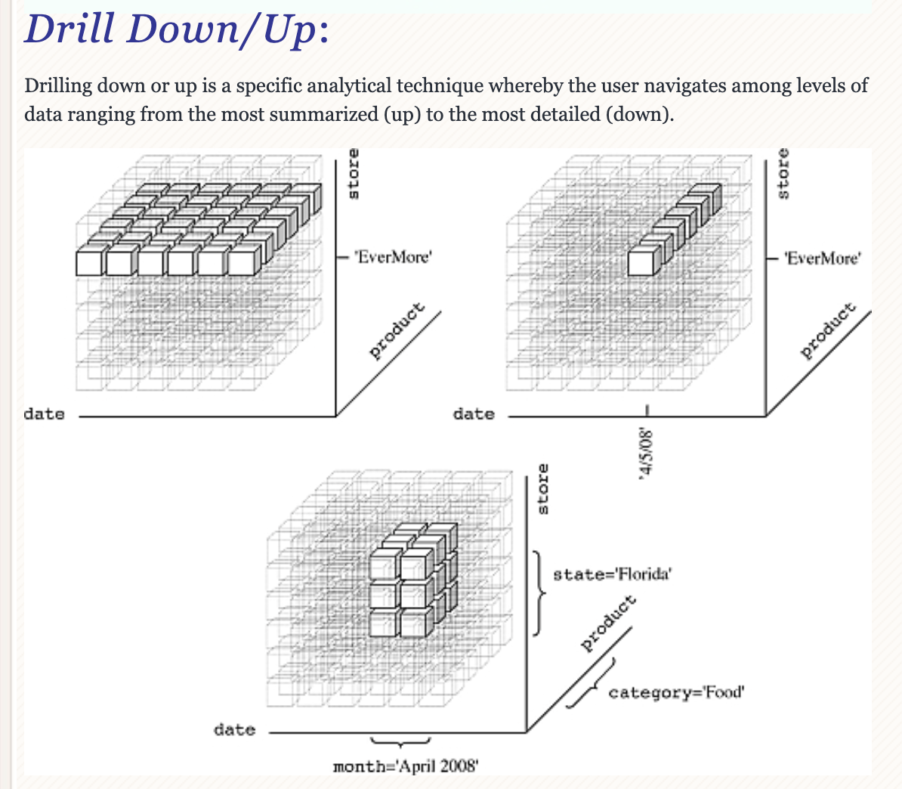
Drilling

Slide 26
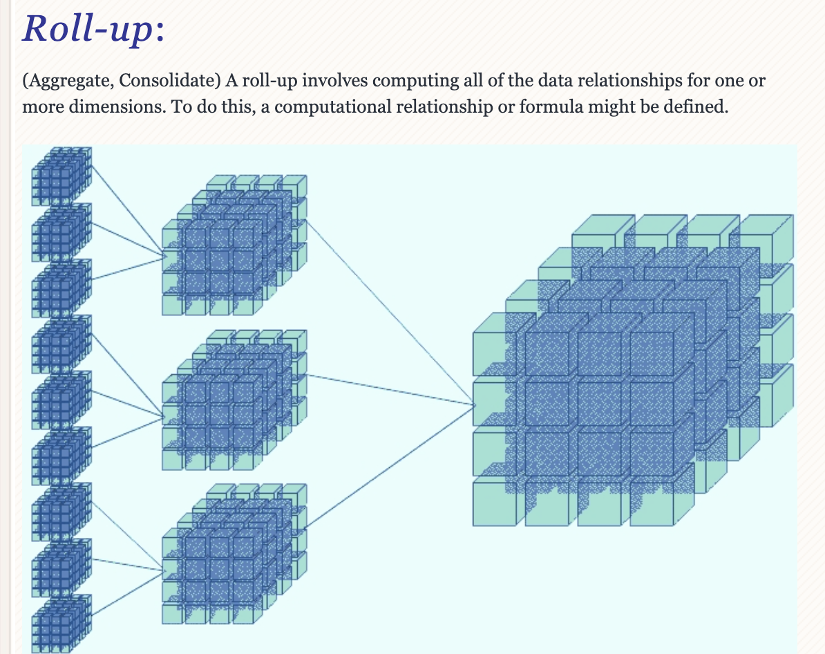
Roll-up

Slide 27
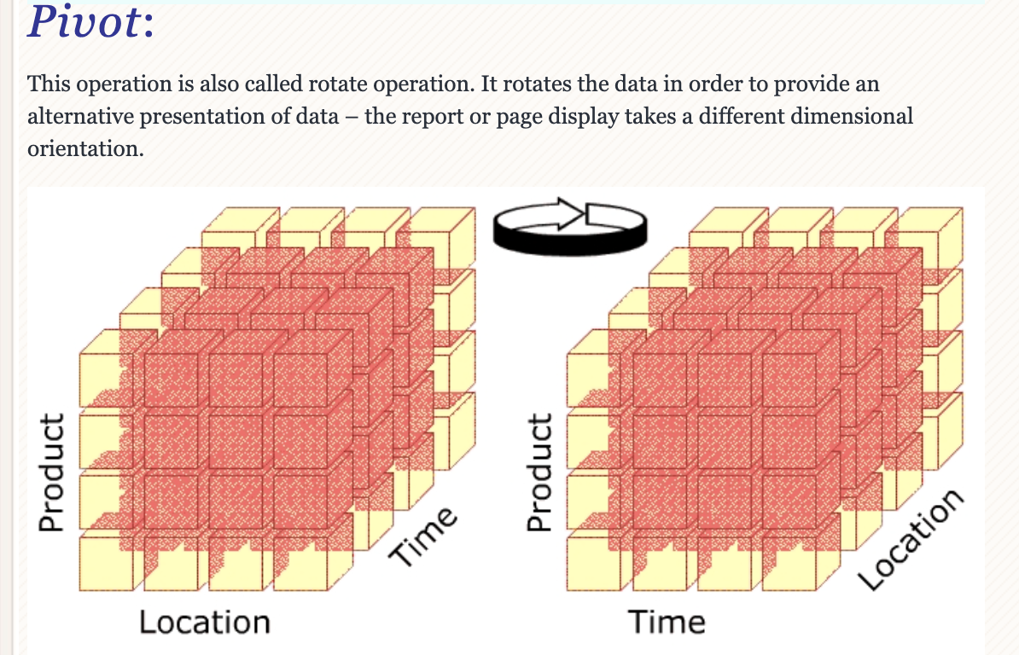
Pivot

Slide 28
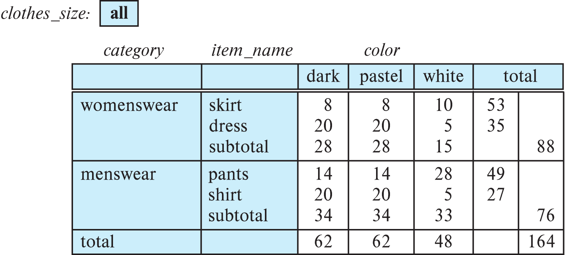
Cross Tabulation With Hierarchy
Cross-tabs can be easily extended to deal with hierarchies
Can drill down or roll up on a hierarchy
E.g. hierarchy: item_name → category

Slide 29
Switch to Notebook
./W4111-2024S-13-Examples.ipynb

Slide 30
Summary
OLAP is a very useful model for analyzing business data, typically data that is inherently tabular to begin with.
There are pure OLAP databases, but a more common approach is:
Use a relational database.
Define a star schema.
ETL from the operational data into the star schema.
“Translate” the logical OLAP operations into SQL queries and predefined views.
What is it that you really care about?
In the past, I had students build a star schema from Classic Models and do OLAP-like queries. You will not have OLAP on a HW.
For the final, you will be responsible for understanding the concepts. For example, it is very common for me to provide some schema/data and ask you to define a star schema and some hypothetical queries.

Slide 31
Big Data
Data Engineering
Data Analysis

Slide 32
Big Data

Slide 33
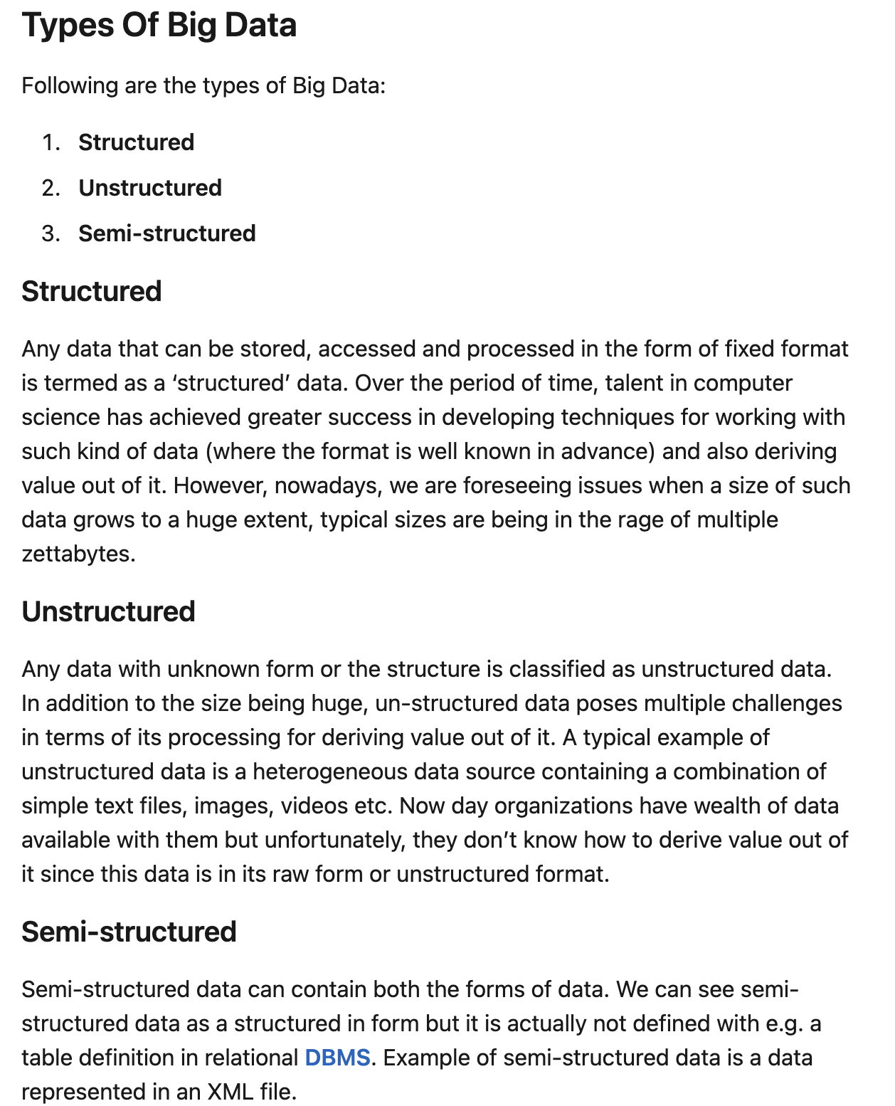
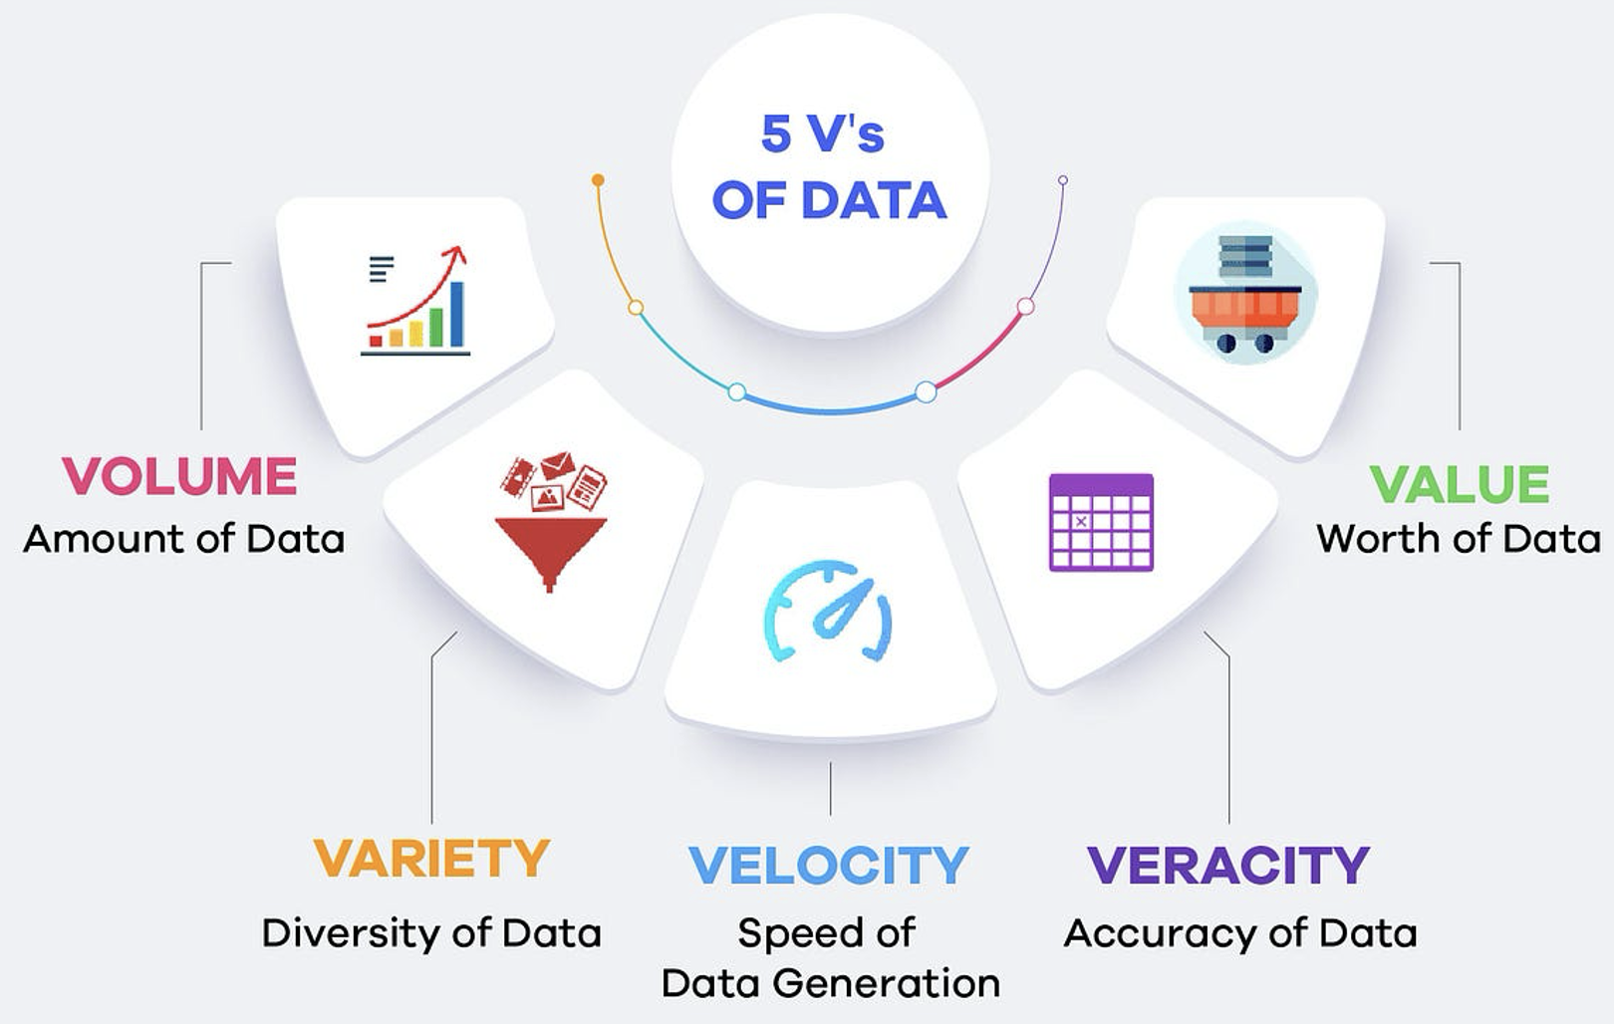
5 V’s of Big Data
https://www.linkedin.com/pulse/big-data-management-revolutio-parichehr-esmailian/
https://medium.com/@get_excelsior/big-data-explained-the-5v-s-of-data-ae80cbe8ded1

Slide 34
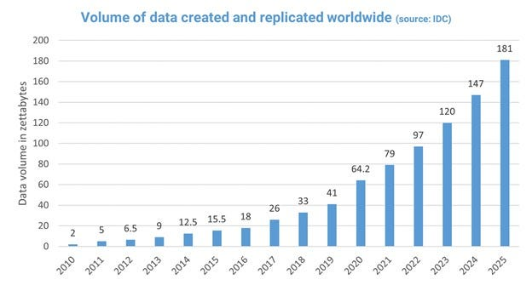
Growth in Big Data
https://medium.com/@mwaliph/exponential-growth-of-data-2f53df89124

Slide 35
Overview
Data analytics: the processing of data to infer patterns, correlations, or models for prediction
Primarily used to make business decisions
Per individual customer
E.g., what product to suggest for purchase
Across all customers
E.g., what products to manufacture/stock, in what quantity
Critical for businesses today

Slide 36
Overview (Cont.)
Common steps in data analytics
Gather data from multiple sources into one location
Data warehouses also integrated data into common schema
Data often needs to be extracted from source formats, transformed to common schema, and loaded into the data warehouse
Can be done as ETL (extract-transform-load), or ELT (extract-load-transform)
Generate aggregates and reports summarizing data
Dashboards showing graphical charts/reports
Online analytical processing (OLAP) systems allow interactive querying
Statistical analysis using tools such as R/SAS/SPSS
Including extensions for parallel processing of big data
Build predictive models and use the models for decision making

Slide 37
Overview (Cont.)
Predictive models are widely used today
E.g., use customer profile features (e.g. income, age, gender, education, employment) and past history of a customer to predict likelihood of default on loan
and use prediction to make loan decision
E.g., use past history of sales (by season) to predict future sales
And use it to decide what/how much to produce/stock
And to target customers
Other examples of business decisions:
What items to stock?
What insurance premium to change?
To whom to send advertisements?

Slide 38
Overview (Cont.)
Machine learning techniques are key to finding patterns in data and making predictions
Data mining extends techniques developed by machine-learning communities to run them on very large datasets
The term business intelligence (BI) is synonym for data analytics
The term decision support focuses on reporting and aggregation

Slide 39
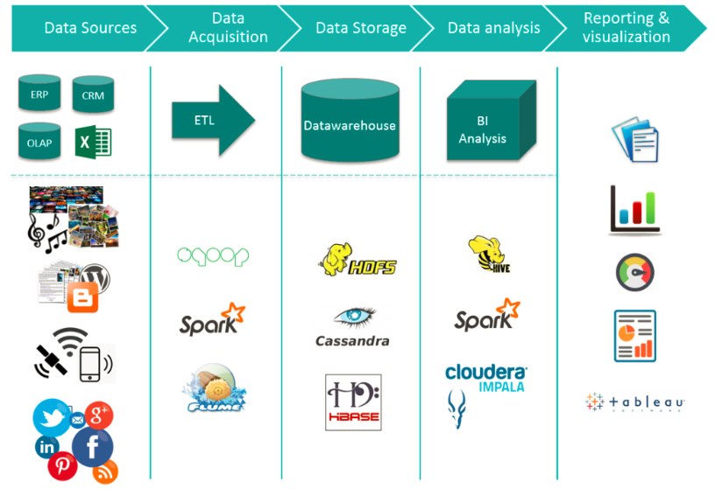
Big Data Ecosystem/Platform
https://medium.com/@jain6968/big-data-ecosystem-b0e4c923d7aa

Slide 40
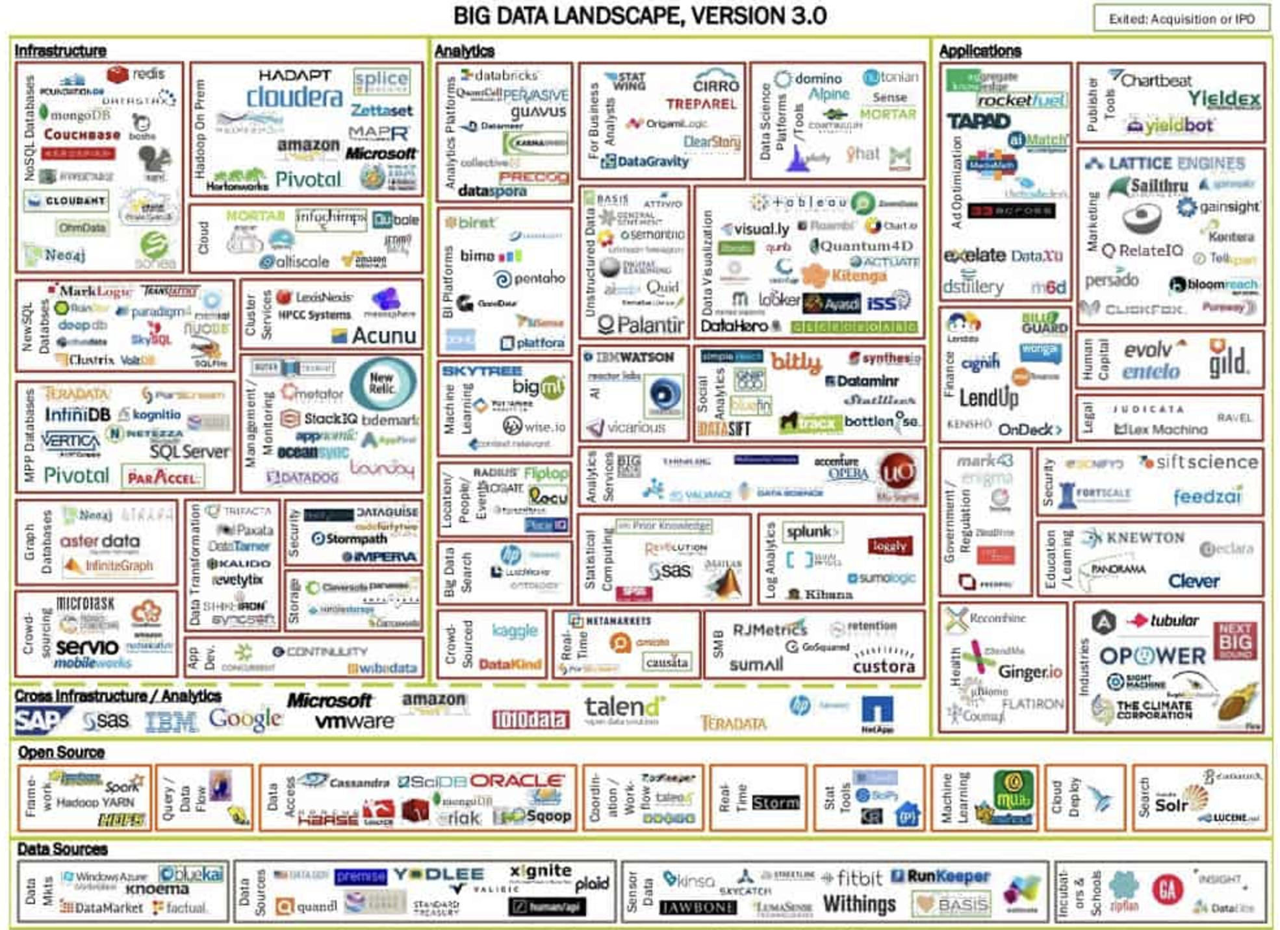
Big Data Ecosystem/Platform
https://dataconomy.com/2014/06/03/understanding-big-data-ecosystem/

Slide 41
Data Engineering

Slide 42
Data Warehouse and Data Lake

Slide 43
ETL Concepts
https://databricks.com/glossary/extract-transform-load

Slide 44
MapReduce
MapReduce is a data flow program with relatively simple operators on the data set.
op1
op2
op3
With each operator implemented in parallel on multiple nodes for performance.
What we want more complex “operators?”

Slide 45
The Value of Blocks
The “normal” file system abstraction is a stream.
Consider a very large CSV file:
We can read using the normal file system functions and APIs,
But we have no idea where records start/end, and
Which records on on which blocks.
➔
Parallel processing of data in a file is very hard using the stream model.
Databases, big data tools, etc. surface concepts of record size, block I/Os, mapping of and organization of records to blocks, block location, … … ➔
Can exploit module processors to parallel process large datasets.
Organize the data to optimize processing, file I/Os, etc.

Slide 46
Parallel Processing of MapReduce Job
User
Program
copy
copy
copy
Master
assign
map
assign
reduce
Part 1
Map 1
Reduce 1
File 1
Part 2
Part 3
Map 2
Reduce 1
write
File 2
Part 4
local
write
Part n
read
Map n
Reduce m
File m
Remote
Read, Sort
Input file
partitions
Intermediate
files
Output files

Slide 47
Map Reduce vs. Databases
Map Reduce widely used for parallel processing
Google, Yahoo, and 100’s of other companies
Example uses: compute PageRank, build keyword indices, do data analysis of web click logs, ….
Allows procedural code in map and reduce functions
Allows data of any type
Many real-world uses of MapReduce cannot be expressed in SQL
But many computations are much easier to express in SQL
Map Reduce is cumbersome for writing simple queries

Slide 48
Map Reduce vs. Databases (Cont.)
Relational operations (select, project, join, aggregation, etc.) can be expressed using Map Reduce
SQL queries can be translated into Map Reduce infrastructure for execution
Apache Hive SQL, Apache Pig Latin, Microsoft SCOPE
Current generation execution engines support not only Map Reduce, but also other algebraic operations such as joins, aggregation, etc. natively.

Slide 49
Algebraic Operations
Current generation execution engines
Natively support algebraic operations such as joins, aggregation, etc. natively.
Allow users to create their own algebraic operators
Support trees of algebraic operators that can be executed on multiple nodes in parallel
E.g. Apache Tez, Spark
Tex provides low level API; Hive on Tez compiles SQL to Tez
Spark provides more user-friendly API
In the relational model,
The are relations.
A fixed set of operators that produce relations from relations (closed).
Are declarative languages and compute the execution graph/plan.
The Spark/... ... engines:
RDDs, Data Frames
Enable programmers to develop and add new operators.
Operators convert reliable distributed datasets/data frames to new RDDs/data frames.
Data engineer explicitly defines the execution graph (data flow).

Slide 50
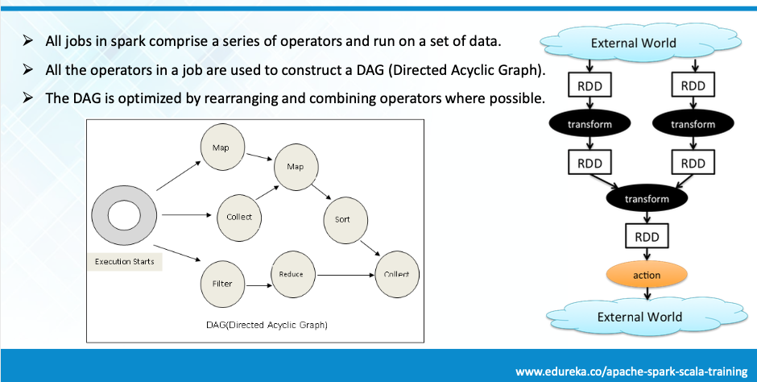
Spark

Slide 51
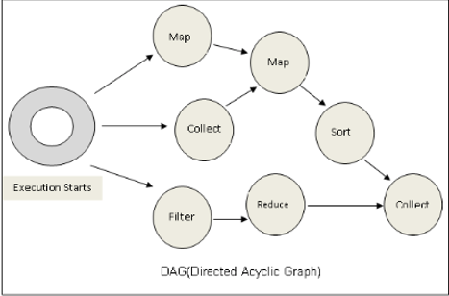
Spark
Conceptually similar to query evaluation graph, but ...
You explicitly define the graph.
You can develop your own operators.

Slide 52
Algebraic Operations in Spark
Resilient Distributed Dataset (RDD) abstraction
Collection of records that can be stored across multiple machines
RDDs can be created by applying algebraic operations on other RDDs
RDDs can be lazily computed when needed
Spark programs can be written in Java/Scala/R
Our examples are in Java
Spark makes use of Java 8 Lambda expressions; the code
s - > Arrays.asList(s.split(" ")).iterator()
defines unnamed function that takes argument s and executes the expression Arrays.asList(s.split(" ")).iterator() on the argument
Lambda functions are particularly convenient as arguments to map, reduce and other functions

Slide 53
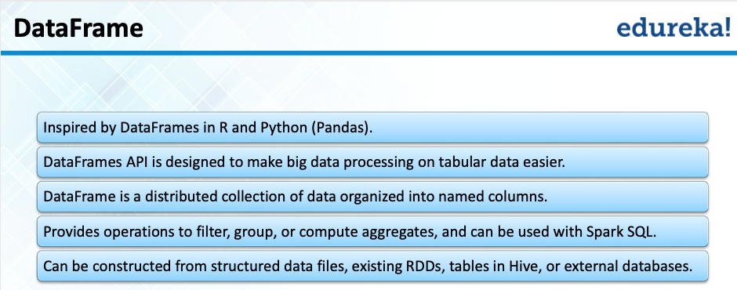
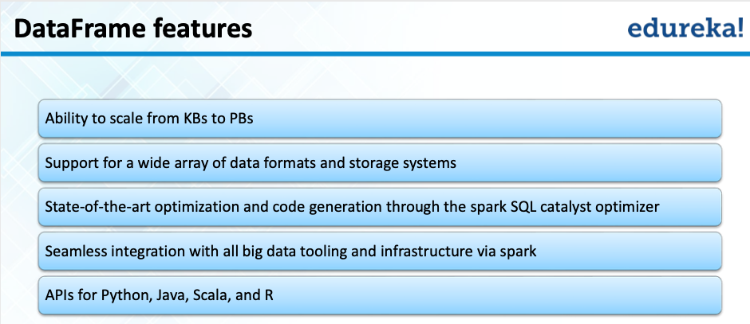
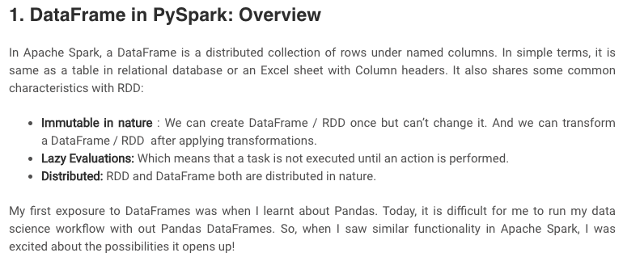
Spark/PySpark
https://www.analyticsvidhya.com/blog/2016/10/spark-dataframe-and-operations/

Slide 54
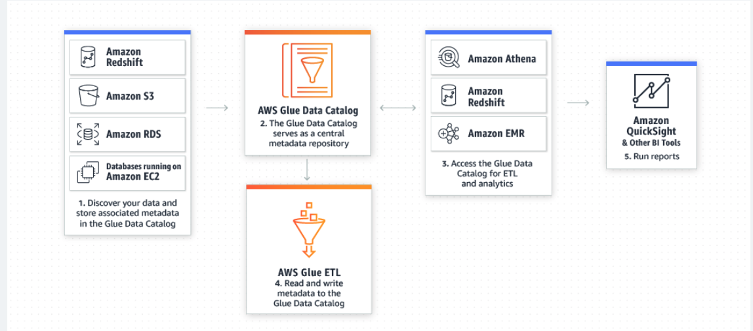
AWS Glue Supports Spark
AWS Glue is a serverless data preparation service that makes it easy for data engineers, extract, transform, and load (ETL) developers, data analysts, and data scientists to extract, clean, enrich, normalize, and load data.

Slide 55
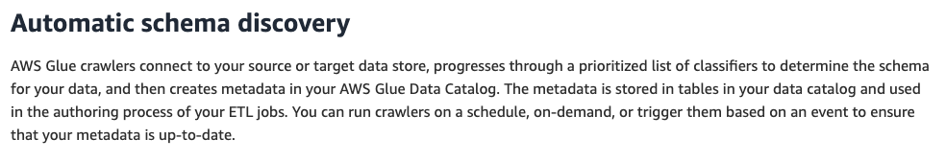
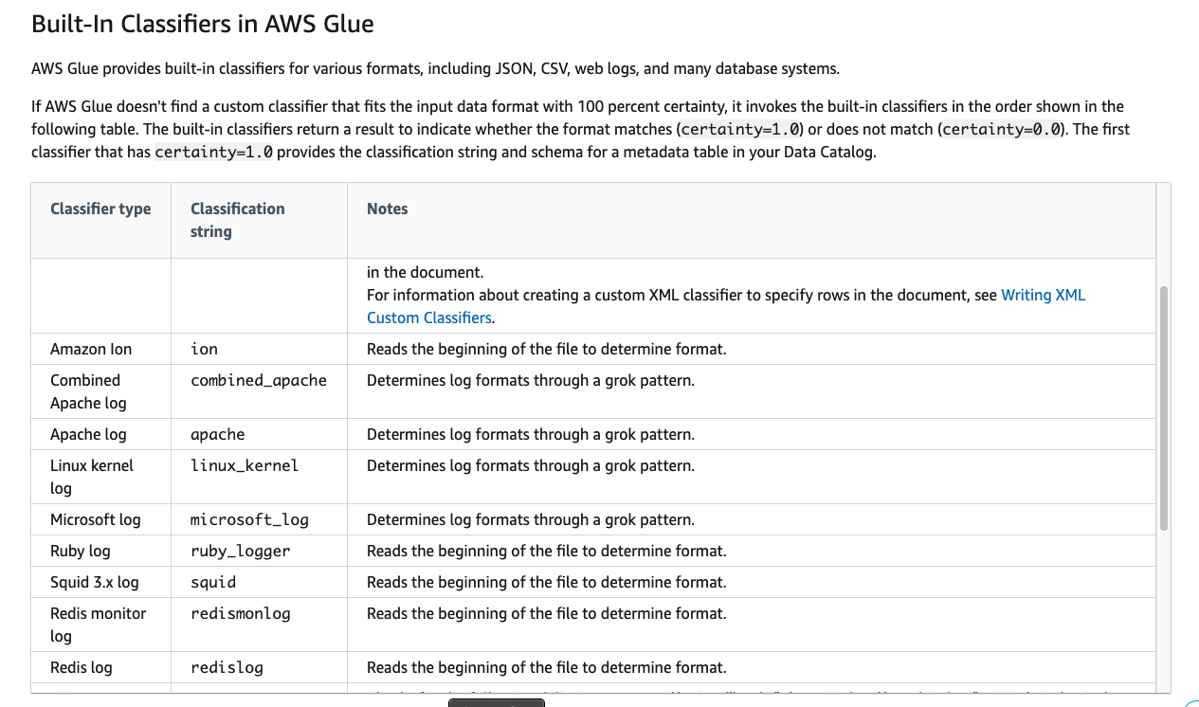
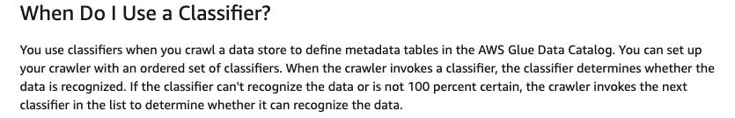
Crawlers/Classifiers

Slide 56
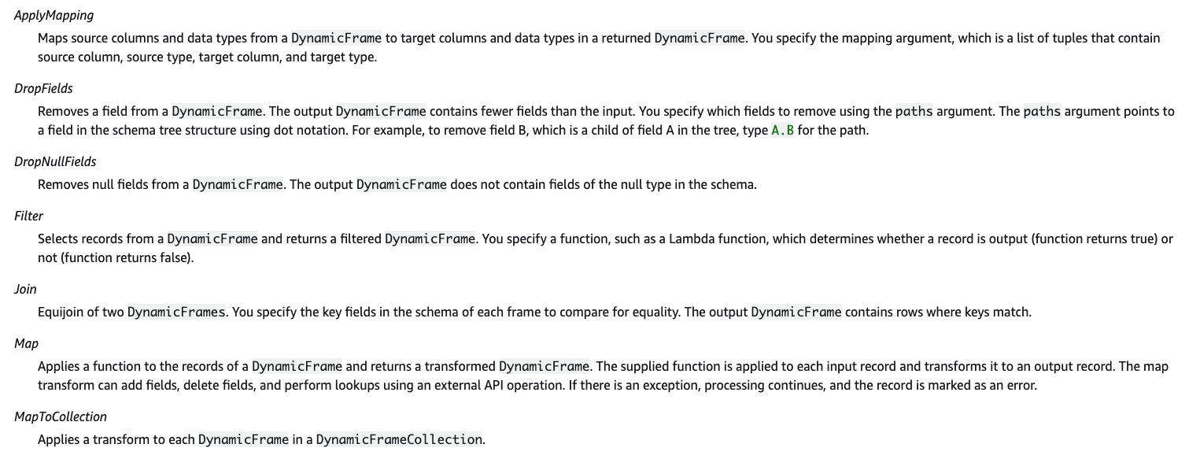
Built-In Transforms

Slide 57
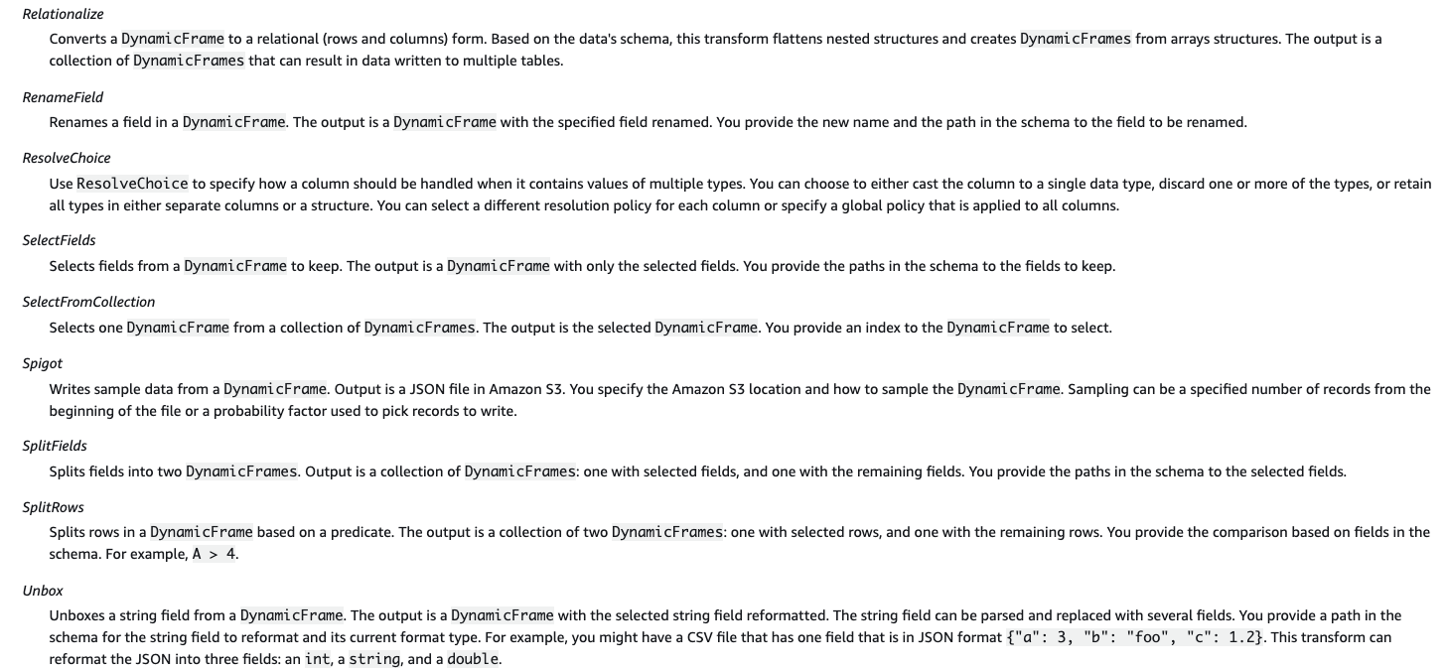
Built-In Transforms

Slide 58
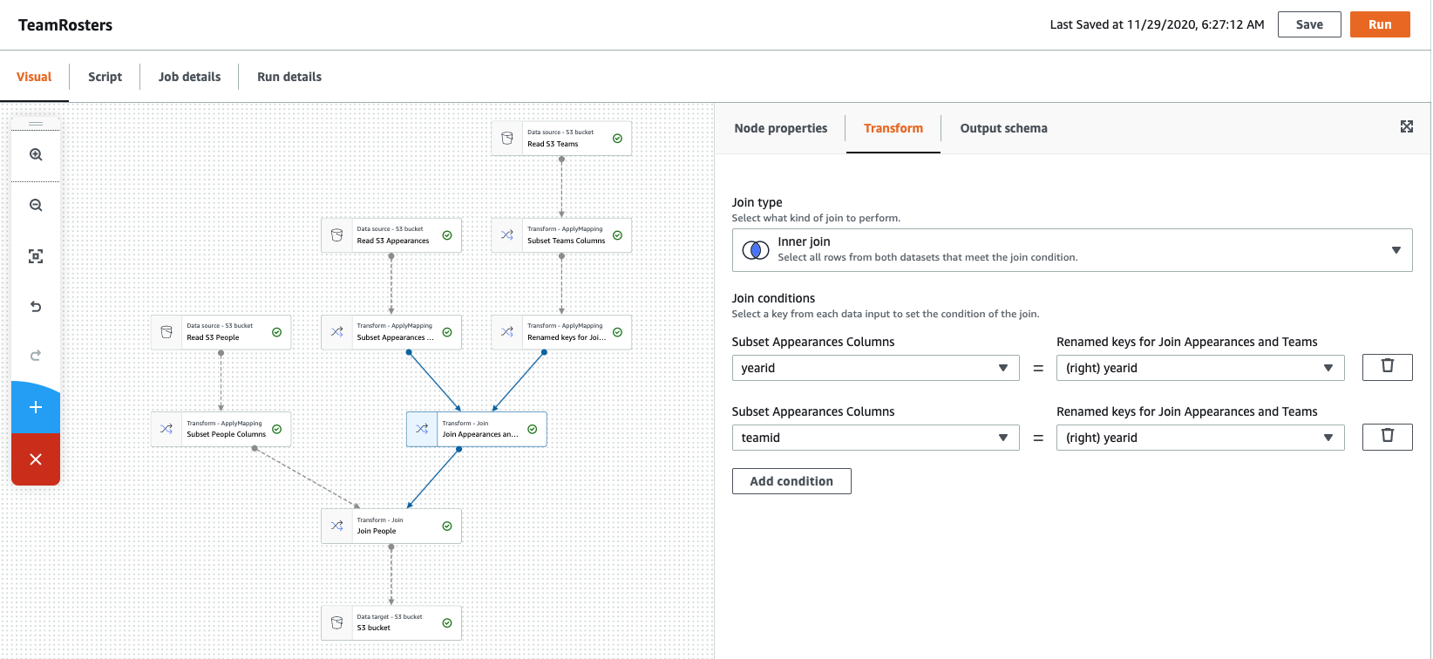
Visual Tools (There are similar tools for SQL, ETL, ... ...)

Slide 59
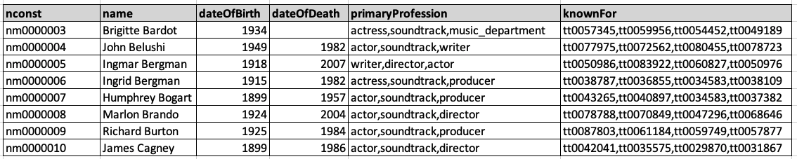
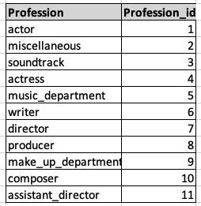
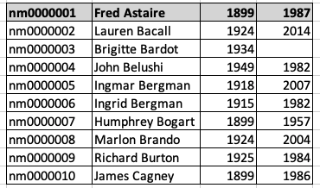
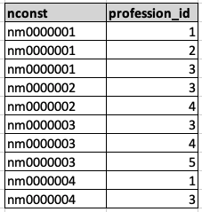
Conceptual Example
Consider the IMDB dataset. We should convert (other conversion needed)
To
You did some operators for this example in homework, and I did in class.

Slide 60
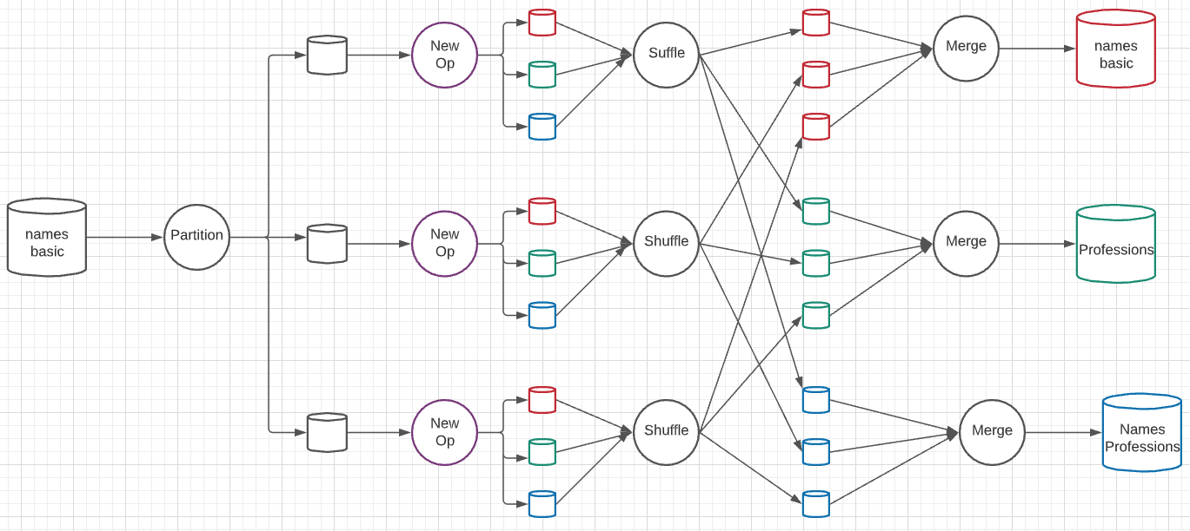
A New Algebraic Operator
Input is a dataset and column ID
Output is three datasets: dataset with column removed, table of distinct column values, associative entity.
Parallelism level is 3 simultaneous services at each stage.

Slide 61
External Material
Show external tutorials
https://www.datacamp.com/tutorial/pyspark-tutorial-getting-started-with-pyspark
https://www.tutorialspoint.com/pyspark/index.htm
Page through PDF touching on key components ./sparkknolx-190107072101.pdf
Go through examples:
/Users/donald.ferguson/Dropbox/000/00-Current-Repos/pySpark
process_imdb.ipynb
Localhost:4040 for Spark console.

Slide 62
Streaming Data

Slide 63
Streaming Data and Applications
Streaming data refers to data that arrives in a continuous fashion
Contrast to data-at-rest
Applications include:
Stock market: stream of trades
e-commerce site: purchases, searches
Sensors: sensor readings
Internet of things
Network monitoring data
Social media: tweets and posts can be viewed as a stream
Queries on streams can be very useful
Monitoring, alerts, automated triggering of actions

Slide 64
Querying Streaming Data
Approaches to querying streams:
Windowing: Break up stream into windows, and queries are run on windows
Stream query languages support window operations
Windows may be based on time or tuples
Must figure out when all tuples in a window have been seen
Easy if stream totally ordered by timestamp
Punctuations specify that all future tuples have timestamp greater that some value
Continuous Queries: Queries written e.g. in SQL, output partial results based on stream seen so far; query results updated continuously
Have some applications, but can lead to flood of updates

Slide 65
Querying Streaming Data (Cont.)
Approaches to querying streams (Cont.):
Algebraic operators on streams:
Each operator consumes tuples from a stream and outputs tuples
Operators can be written e.g., in an imperative language
Operator may maintain state
Pattern matching:
Queries specify patterns, system detects occurrences of patterns and triggers actions
Complex Event Processing (CEP) systems
E.g., Microsoft StreamInsight, Flink CEP, Oracle Event Processing

Slide 66
Stream Processing Architectures
Many stream processing systems are purely in-memory, and do not persist data
Lambda architecture: split stream into two, one output goes to stream processing system and the other to a database for storage
Easy to implement and widely used
But often leads to duplication of querying effort, once on streaming system and once in database

Slide 67
Stream Extensions to SQL
SQL Window functions described in Section 5.5.2
Streaming systems often support more window types
Tumbling window
E.g., hourly windows, windows don’t overlab
Hopping window
E.g., hourly window computed every 20 minutes
Sliding window
Window of specified size (based on timestamp interval or number of tuples) around each incoming tuple
Session window
Groups tuples based on user sessions

Slide 68
Window Syntax in SQL
Windowing syntax varies widely by system
E.g., in Azure Stream Analytics SQL:
select item, System.Timestamp as window end, sum(amount) from order timestamp by datetime group by itemid, tumblingwindow(hour, 1)
Aggregates are applied on windows
Result of windowing operation on a stream is a relation
Many systems support stream-relation joins
Stream-stream joins often require join conditions to specify bound on timestamp gap between matching tuples
E.g., tuples must be at most 30 minutes apart in timestamp

Slide 69
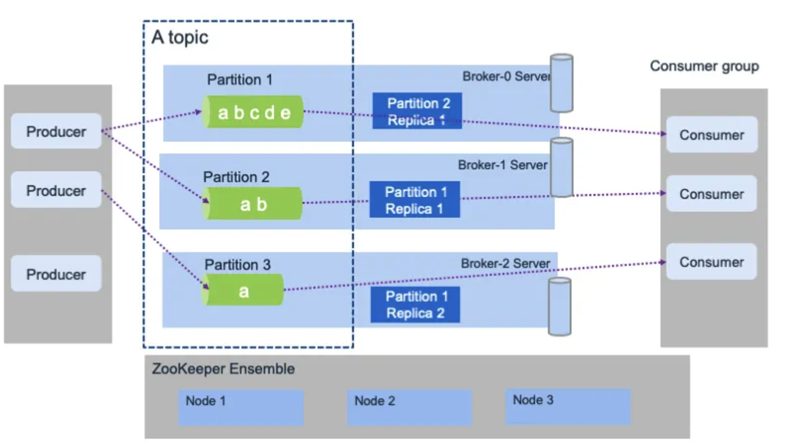
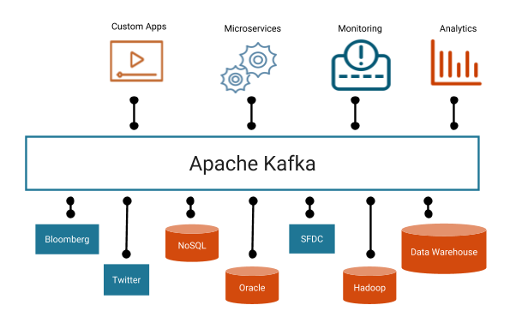
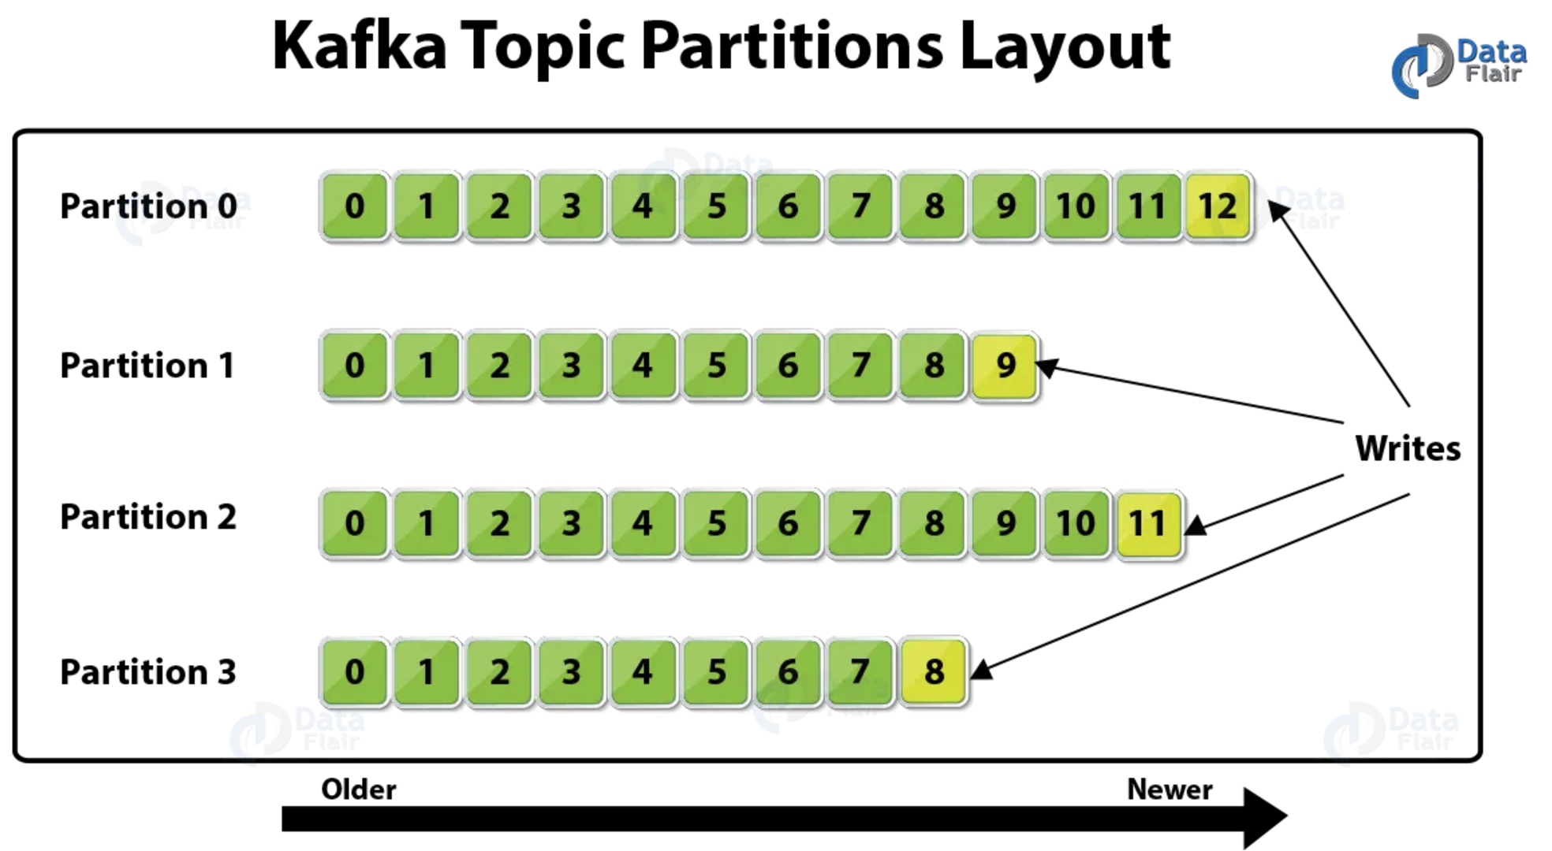
Stream Processing – Kafka Example
Kafka architecture has 4 actors:
Broker
Zookeeper
Producer
Consumer
There may be multiple brokers and multiple topics.
Topics are divided into partitions based on an event/ message key to enable parallelism.

Slide 70
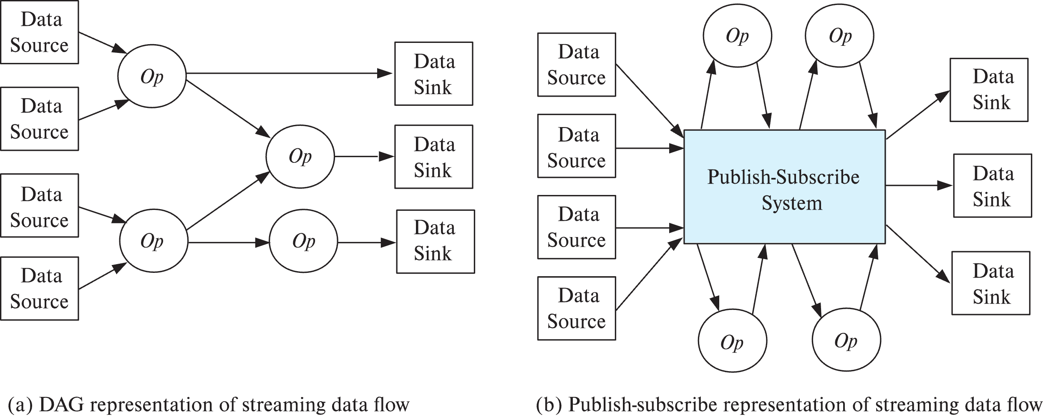
Algebraic Operations on Streams
Tuples in streams need to be routed to operators
Routing of streams using DAG and publish-subscribe representations
Used in Apache Storm and Apache Kafka respective

Slide 71
Publish Subscribe Systems
Publish-subscribe (pub-sub) systems provide convenient abstraction for processing streams
Tuples in a stream are published to a topic
Consumers subscribe to topic
Parallel pub-sub systems allow tuples in a topic to be partitioned across multiple machines
Apache Kafka is a popular parallel pub-sub system widely used to manage streaming data
More details in book

